Slide 1
Dynamic Programming Unit-III

Slide 2
Dynamic programming
Solving problems with overlapping subproblems
Each subproblem solved only once
Result of each subproblem is stored in table to obtain a solution to original subproblem
It is typically applied to optimization problem

Slide 3
Differences
Divide n Conquer
Dynamic programming
Each subproblem is solved independently & then solutios to all subproblems are collected together
Duplications in subsolutions are neglected
Less efficient as rework on solutions
Top-down approach
Splits at specific determinic points
Many decision sequences are generated and all overlapping subinstances are considered
Duplications in subsolutions are avoided totally
More efficient than divide and conquer
Bottom-up approach
Tries all possible split points and determines the optimal one

Slide 4
Differences
Greedy Method
Dynamic programming
Used for obtaining optimal solution
Out of set of feasible solutions, it picks up the optimum one
Optimum solution is without revising previously generated solutions
No guarantee of getting optimum solution
Used for obtaining optimal solution
No special set of feasible solutions
Revises previously obtained solutions
Guarantee of getting optimal solution as the use of principle of optimality

Slide 5
Dynamic Programming
Principle of optimality
In an optimal sequence of decisions or choices, each subsequence must also be optimal
Steps in dynamic programming
Characterize structure of optimal solution
Recursively define the value of an optimal solution
Using bottom-up technique compute the value of optimal solution- use of recurrence relation
Compute optimal solution from the above step

Slide 6
Dynamic Programming
Elements of Dynamic Programming
Optimal substructure
Optimal solution for substructures
Overlapping subproblems
Solution of subproblems are shared to get the final solution

Slide 7
Knapsack problem
We are given n objects and a knapsack or bag. Object i has a weight w_{i} and the knapsack has a capacity m. If a fraction xi, 0 < x_{i} < 1, of object i is placed into the knapsack, then a profit of p_{i}x_{i} is earned.
The objective is to obtain a filling of the knapsack that maximizes the total profit earned.
Since the knapsack capacity is m, we require the total weight of all chosen objects to be at most m.

Slide 8
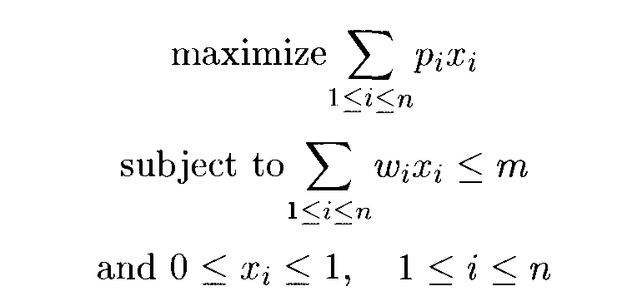
Knapsack problem
Consider the following instance of the knapsack problem:
n = 3,m = 20,(p1,p2,P3) = (25,24,15), and (w1,w2,w3) = (18,15,10).

Slide 9
0/1 Knapsack problem
Value of x_{i} is either 0 or 1
Compute S^{i} which contains pairs (P, W) where P=f_{i}(y_{j}) and W=y_{j}
S⁰={(0, 0) }
We can compute S^{i+1} from S^{i} by first computing

Slide 10
0/1 Knapsack problem
S^{i+1} can be computed by Merging the pairs in si and s^{i}₁ together
If S^{i+1} contains two pairs (P_{j}, w_{j}) and (P_{K}, W_{k}) with the property that p_{j}<=P_{k} and W_{j}>=W_{k}, then the pair (P_{j}, W_{j}) has to be discarded. This is called Purging or Dominance Rule.
Trace back to obtain the optimal solution

Slide 11
0/1 Knapsack problem
Example
Consider the knapsack instance n =3, (W₁,W₂,W₃) = (2,3,4), (P₁,P₂,P₃) = (1,2,5), and m = 6.
For these data we have
S⁰ = {(0,0)}; S⁰₁={(1,2)}
S¹ = {(0,0),(1,2)}; S¹₁={(2,3),(3,5)}
S² = {(0,0), (1,2), (2,3), (3,5)}; S²₁ ={(5,4), (6,6), (7,7), (8,9)}
S³ = {(0,0), (1,2), (2,3), (5,4), (6,6), (7,7), (8,9)}
Tracing back
(6-p3, 6-w3)=(1, 2) is not present in S²
but (1, 2) Є S¹
Hence solution is (1, 0, 1)

Slide 12
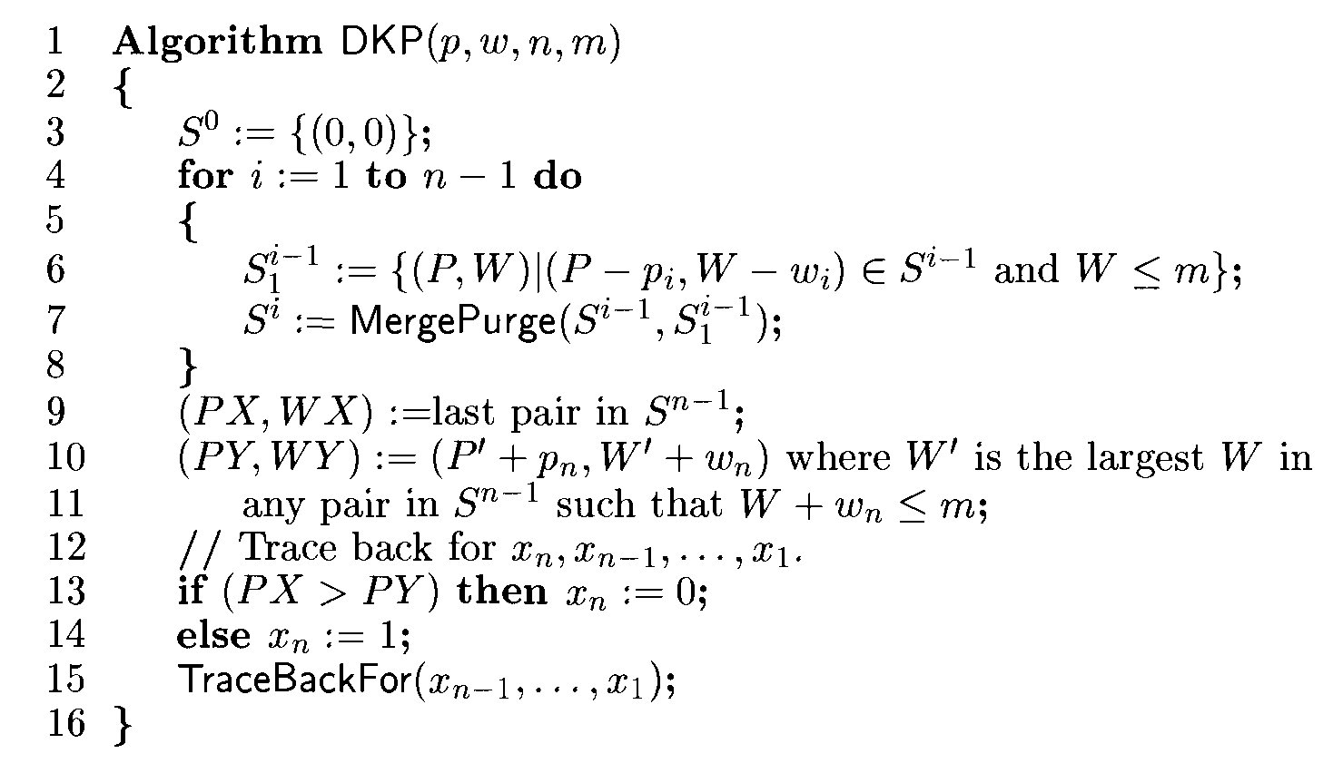
Informal Knapsack algorithm

Slide 13
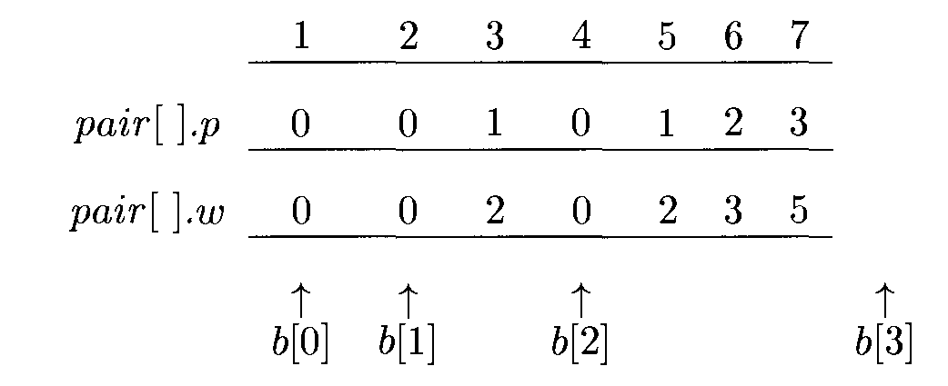
0/1 Knapsack Algorithm
An array pair[] to represent all the pairs(P, W).
Sets S⁰,S¹,….,S^{n-1} can be stored adjacent to each other– use of pointer b[i] –location of first element in S^{i.}

Slide 14
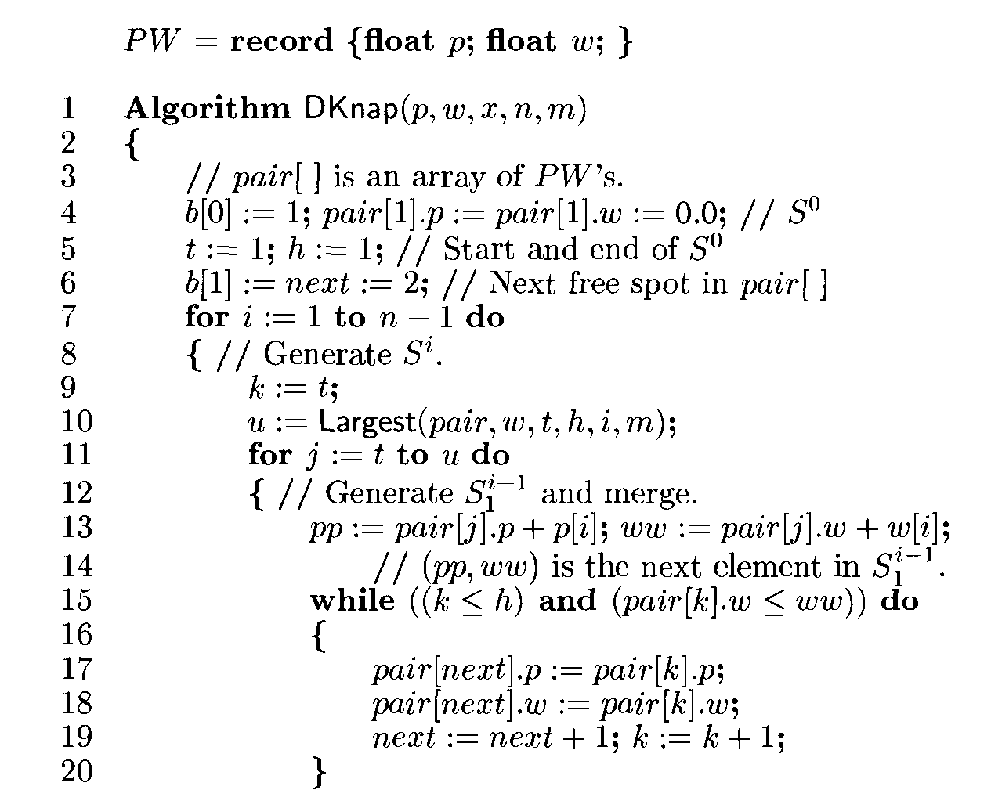
0/1 Knapsack Algorithm

Slide 15
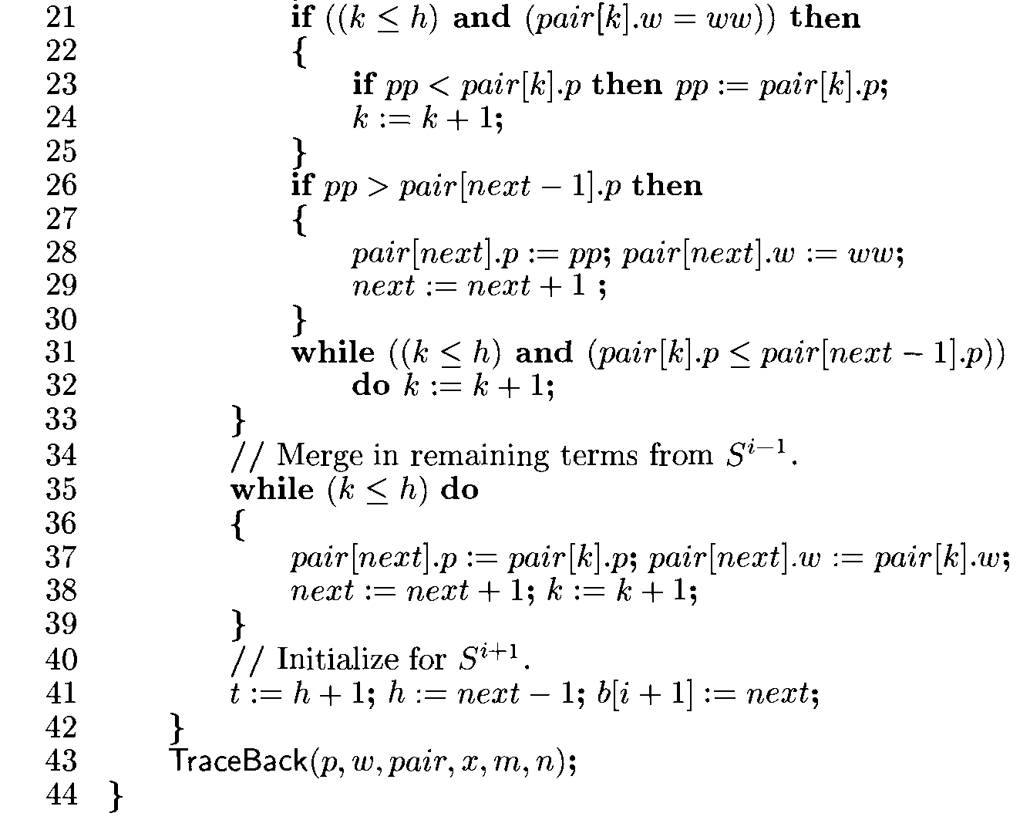
0/1 Knapsack Algorithm

Slide 16
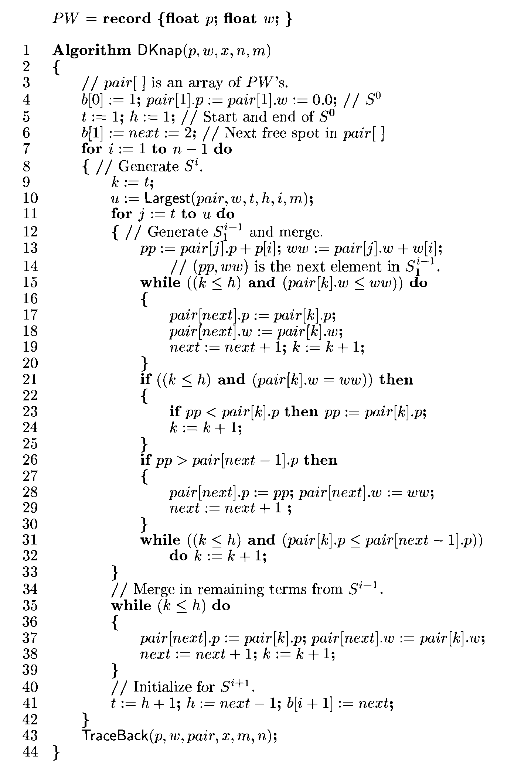

Slide 17
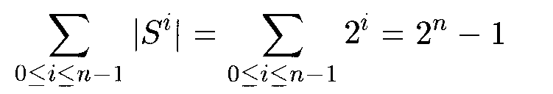
|S^{i}| is the number of pairs in S^{i}
Since each S^{i} , I >0, is obtained by merging S^{i-1} and S^{i-1}₁ and |S^{i-1}₁ |< = |S^{i-1}|,
It follows that |S^{i} |<= 2|S^{i-1}|. In the worst case no pairs will get purged and
time needed to compute all the S^{i} 's is 0(2^{n}).

Slide 18
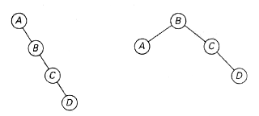
Optimal Binary Search Tree
Binary search tree- implementing a dictionary
In an optimal binary search tree, the average number of comparisons in a search is the smallest possible
consider four keys A, B, C, and D to be searched for with probabilities 0.1, 0.2, 0.4, and 0.3, respectively
Two out of 4 possible binary search trees with keys A, B, C. and D

Slide 19
Optimal Binary Search Tree
The average number of comparisons in a successful search in the first of this trees is
0.1∙1 + 0.2∙2 + 0.4∙3 + 0.3∙4 =2.9
while for the second one it is
0.1∙2+0.2∙1 +0.4∙2+0.3∙3 = 2.1.
Neither of these two trees is, in fact, optimal.

Slide 20
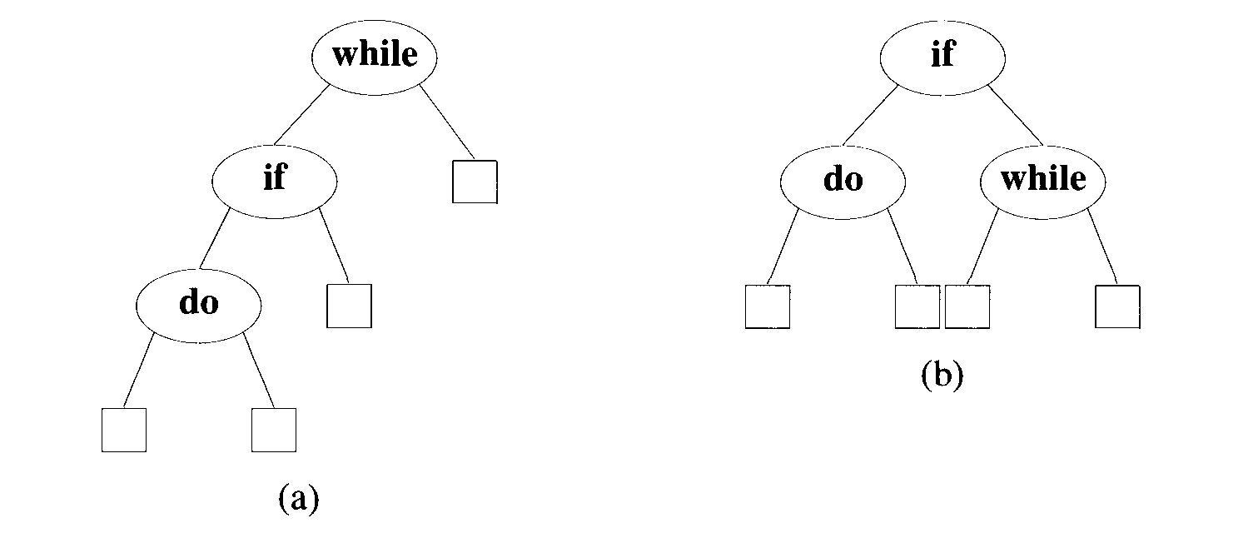
Binary search trees with external nodes
With equal probabilities p(i) = q(i) = 1/7 for all i, we have
cost(tree a) = 15/7 cost (tree b) = 13/7
Cost of a and b= ?

Slide 21
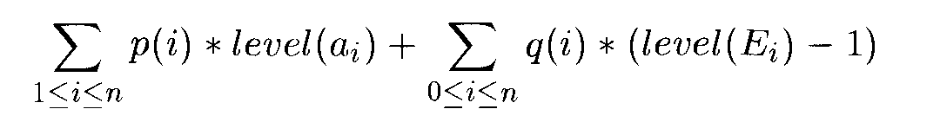
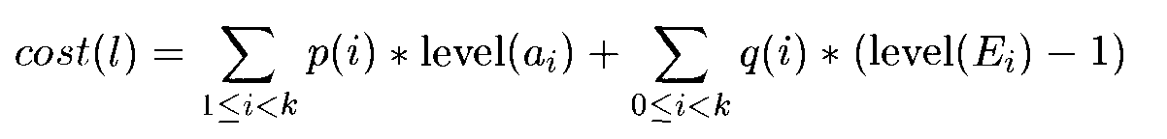
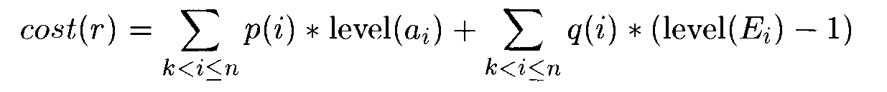
Optimal Binary Search Tree
If we choose a_{k} as the root, then it is clear that the internal nodes for a₁, a₂,..., a_{k-1} as well as the external nodes for the classes E₀, E₁,..., E_{k-1} will lie in the left subtree l of the root.
The remaining nodes will be in the right subtree r.

Slide 22

Optimal Substructure
The expected search cost of the tree increases by the sum of all probabilities in the subtree
w(i,j)=
Expected cost of the search tree is

Slide 23
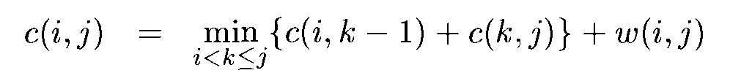
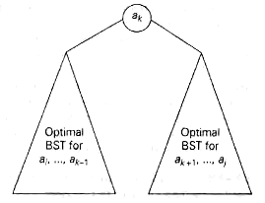

Slide 24
Example
Let n = 4 and (01,02,03,04) = (do, if, int, while). Let
p(l : 4) = (3,3,1,1) and q(0 : 4) = (2, 3,1,1,1). The p's
And q's have been multiplied by 16 for convenience.
Initially, we have w(i,i) = q(i), c(i,i) = 0
and r(i,i) = 0, 0 < i < 4.
By observation w(i,j) = P(j) + q(j) + w(i,j – 1)

Slide 25
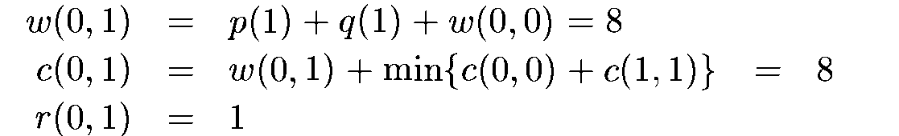
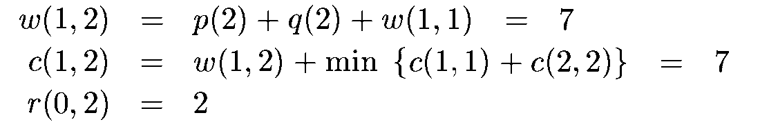
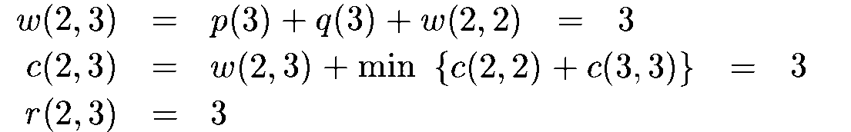
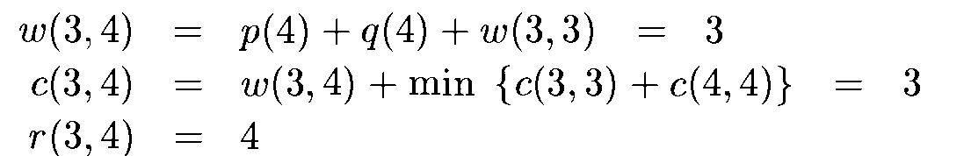
Example

Slide 26
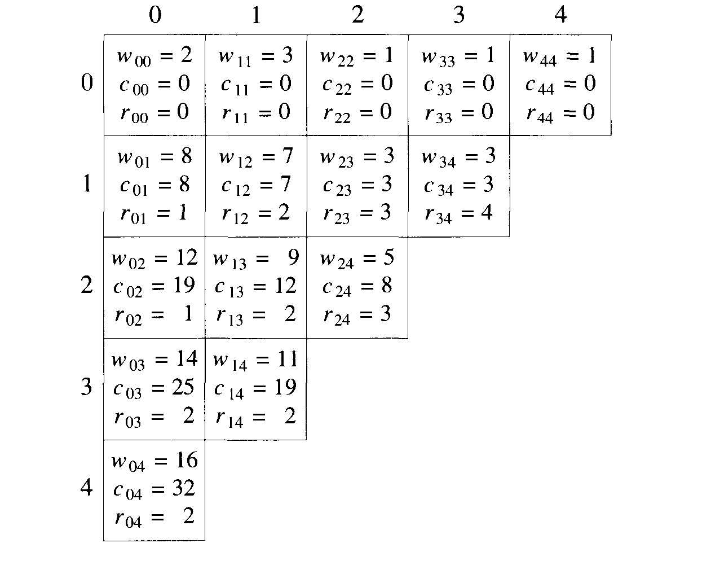
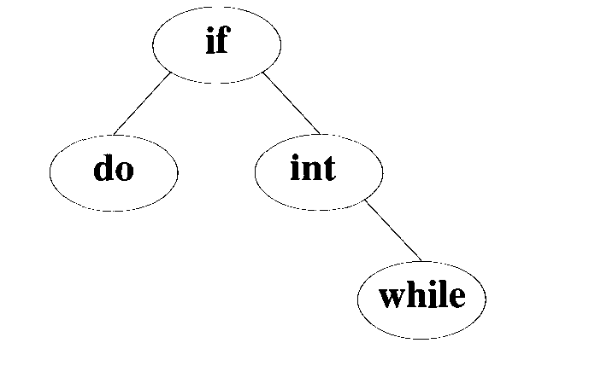
Example

Slide 27
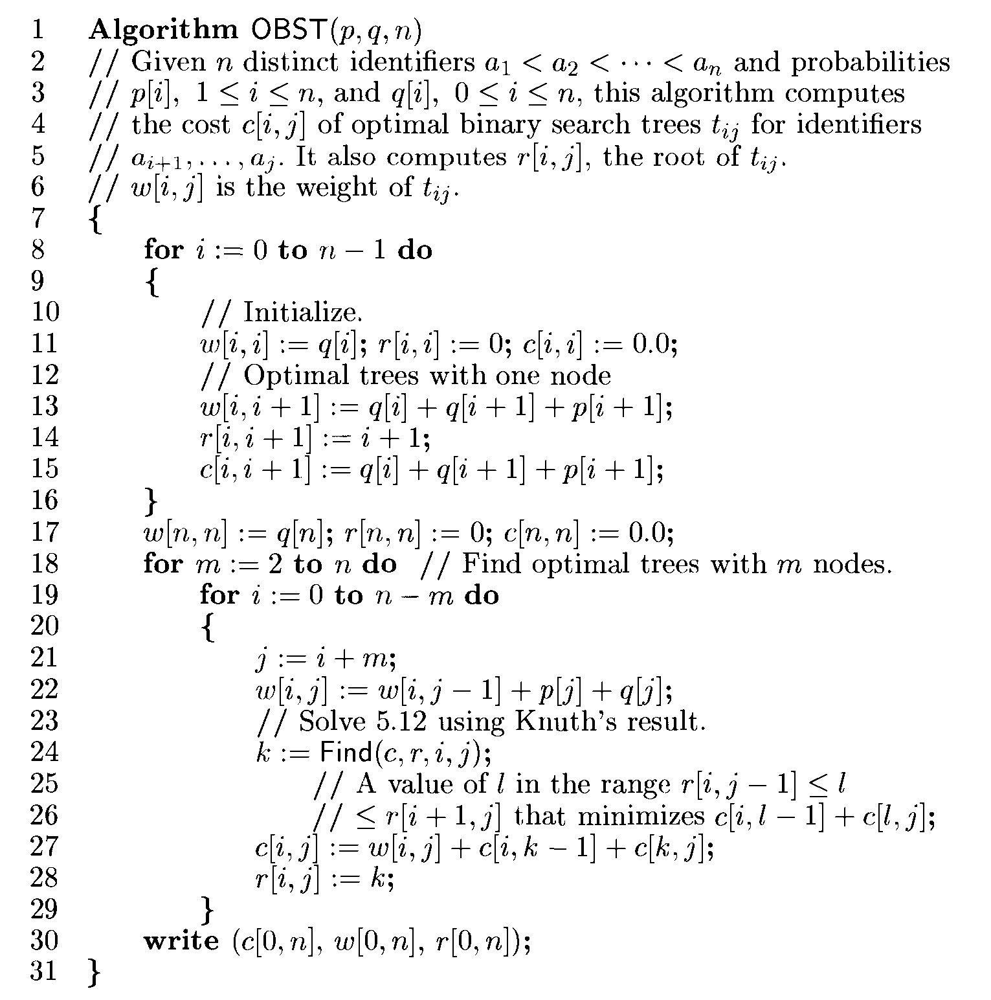

Slide 28
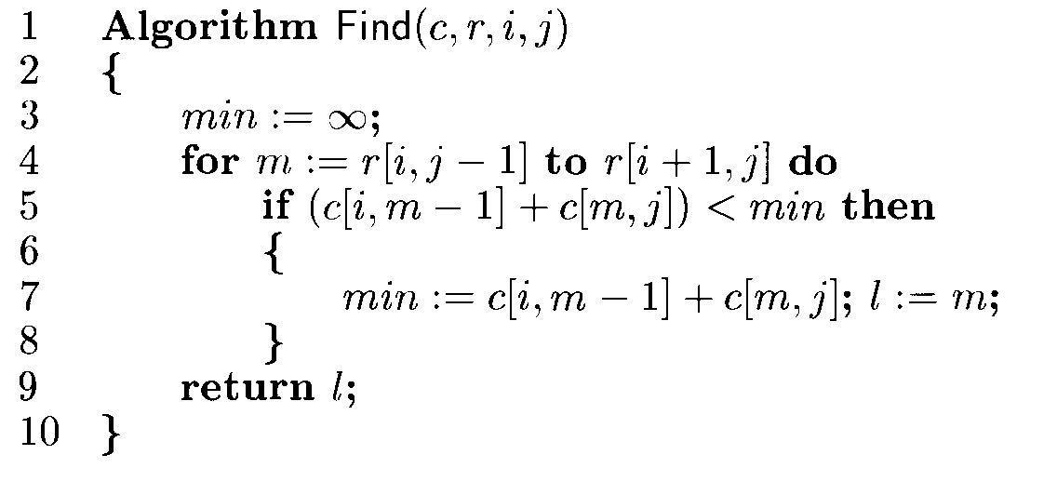
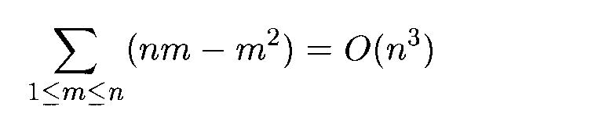
Find requires O(m)- to find minimum of m quantities
Total cost all c(I, j) –O(m(n-m))
Total time to evaluate all c(I, J) is

Slide 29
Input: keys[] = {10, 12, 20}, freq[] = {34, 8, 50}
Cost of OBST=142

Slide 30
Assignment no. 3
Write a program to implement Bellman-Ford Algorithm using Dynamic Programming and verify the time complexity.

Slide 31
Bellman Ford Algorithm
-single source shortest path problem
-can solve problem with negative edges
-Detect negative weight cycle but can not handle it

Slide 32
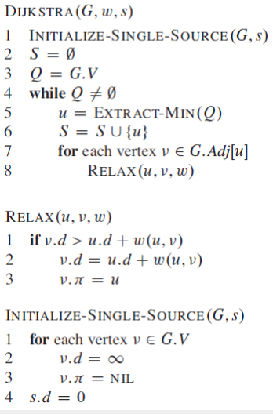

Slide 33
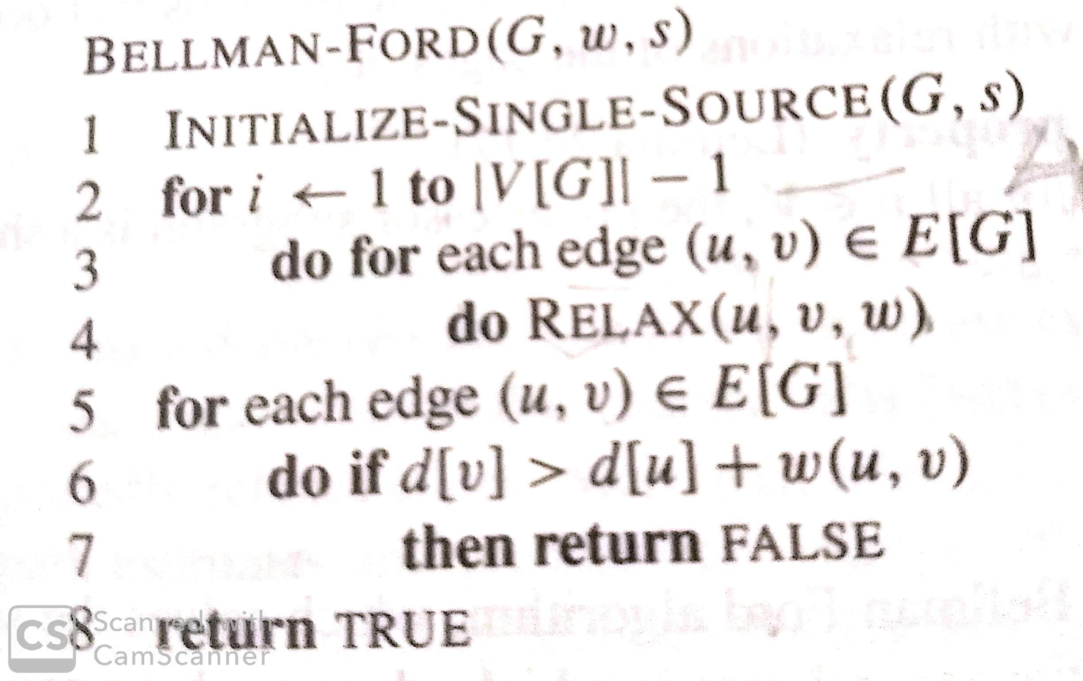

Slide 34
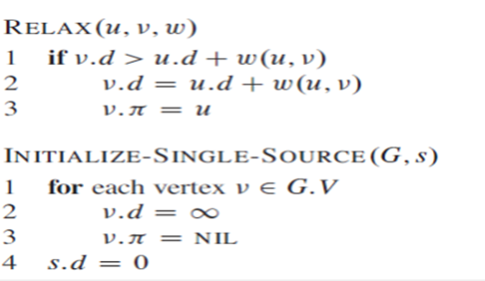

Slide 35
Multistage Graphs

Slide 36
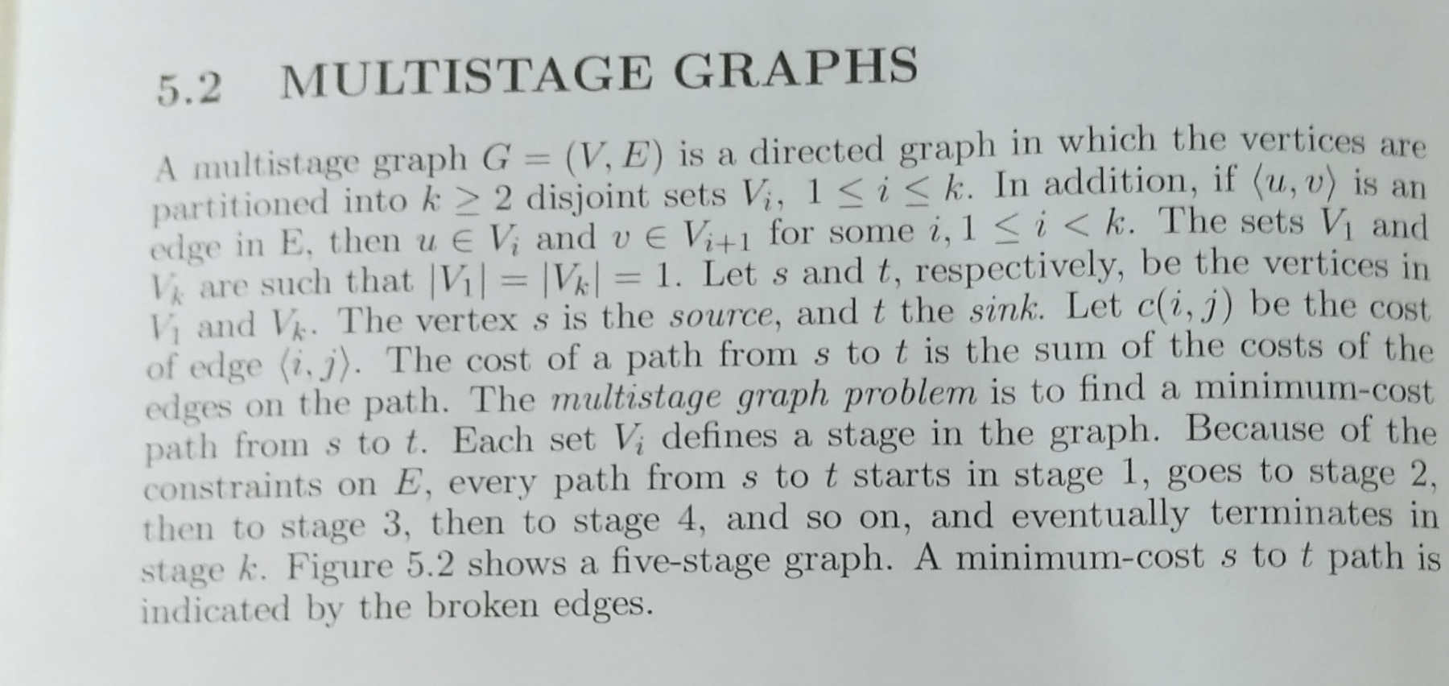

Slide 37
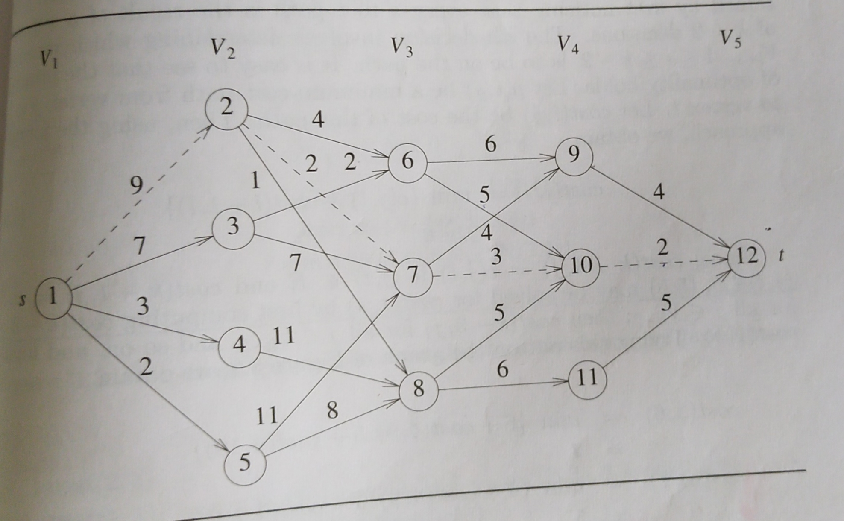

Slide 38
Two approaches
Forward – start from sink-t
Backward-start from source-s

Slide 40
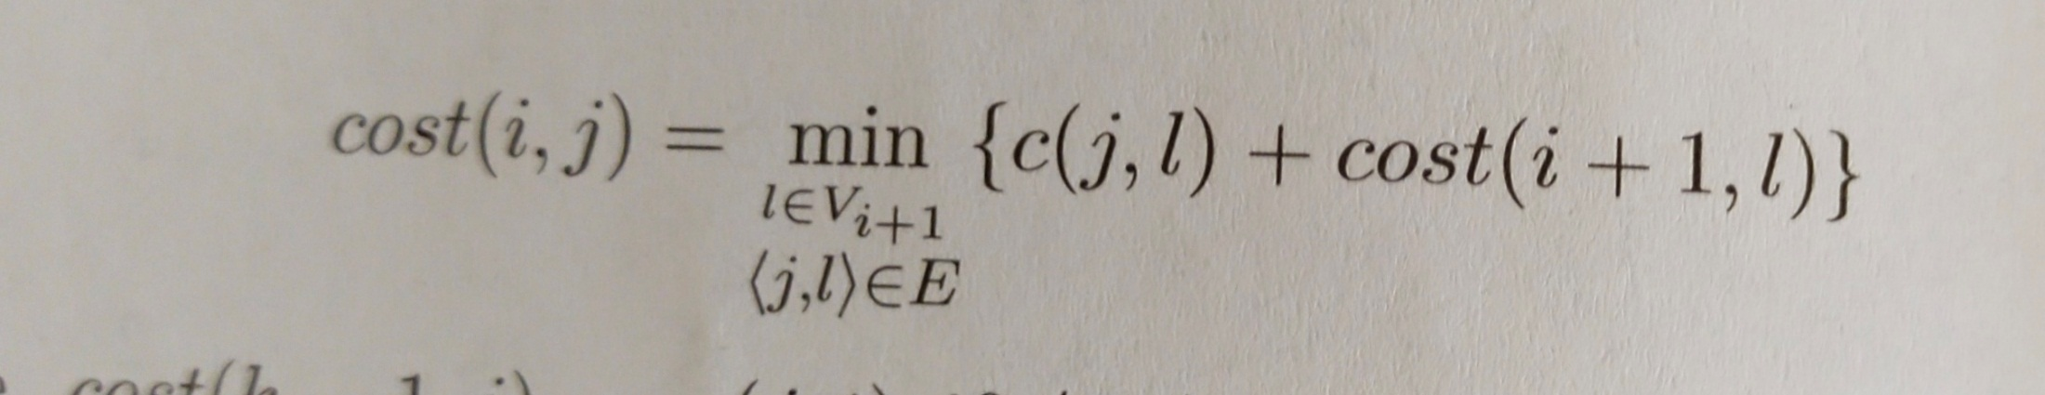

Slide 41
